Slide 1
Assignment 6
Agentic AI for Image Classification

Slide 2
Objective:
Design a multi-agent system where two image classification models are treated as independent agents and evaluated by a third “Judge” agent.
Agents Implemented:
CNN-CIFAR Agent (custom CNN)
RESNET-CIFAR Agent (ResNet-style architecture)
Judge Agent (evaluation & comparison)
Goal:
Compare model performance in terms of:
Accuracy
Inference latency
Prediction behavior

Slide 3
Multi-Agent Architecture Design
Implemented a three-agent architecture:
CNN Agent
Receives image
Returns predicted class + confidence + latency
ResNet Agent
Receives same image
Returns predicted class + confidence + latency
Judge Agent
Sends images to both agents
Collects predictions
Computes:
Accuracy@200
Average latency
Produces summary metrics
Key Idea:
Models are decoupled from evaluation logic → Judge controls benchmarking.

Slide 4
Training & Evaluation Setup
Dataset: CIFAR-10
10 image classes (32x32 RGB)
CPU-only training (resource constraint)
Training Design:
Limited epochs (6–8)
Small subset for fast training
Early stopping enabled
Same preprocessing for both models
Evaluation Design:
Judge compares on 200 test images
Measures:
Classification accuracy
Average inference time (ms)

Slide 5
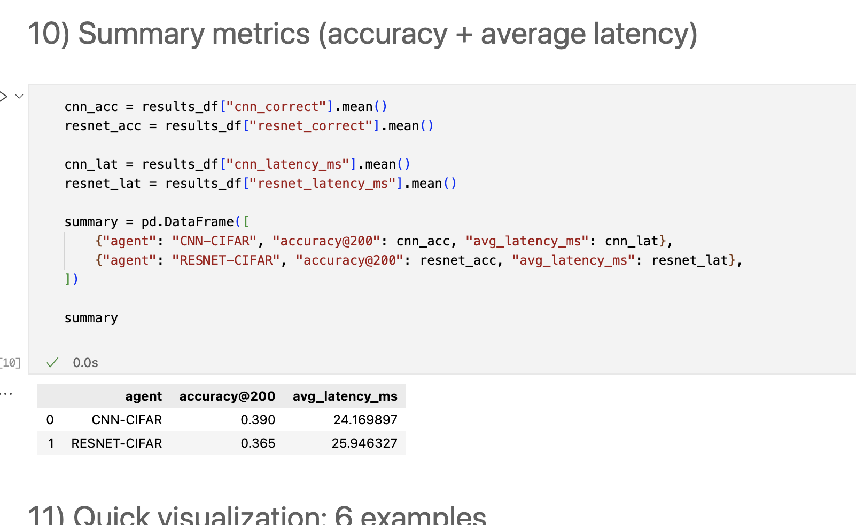
Quantitative Comparison
Observations:
Both models significantly outperform random guessing (10%).
CNN slightly outperformed ResNet in this constrained setting.
Latency difference is minimal.
Shallower networks may converge faster under limited training.

Slide 6
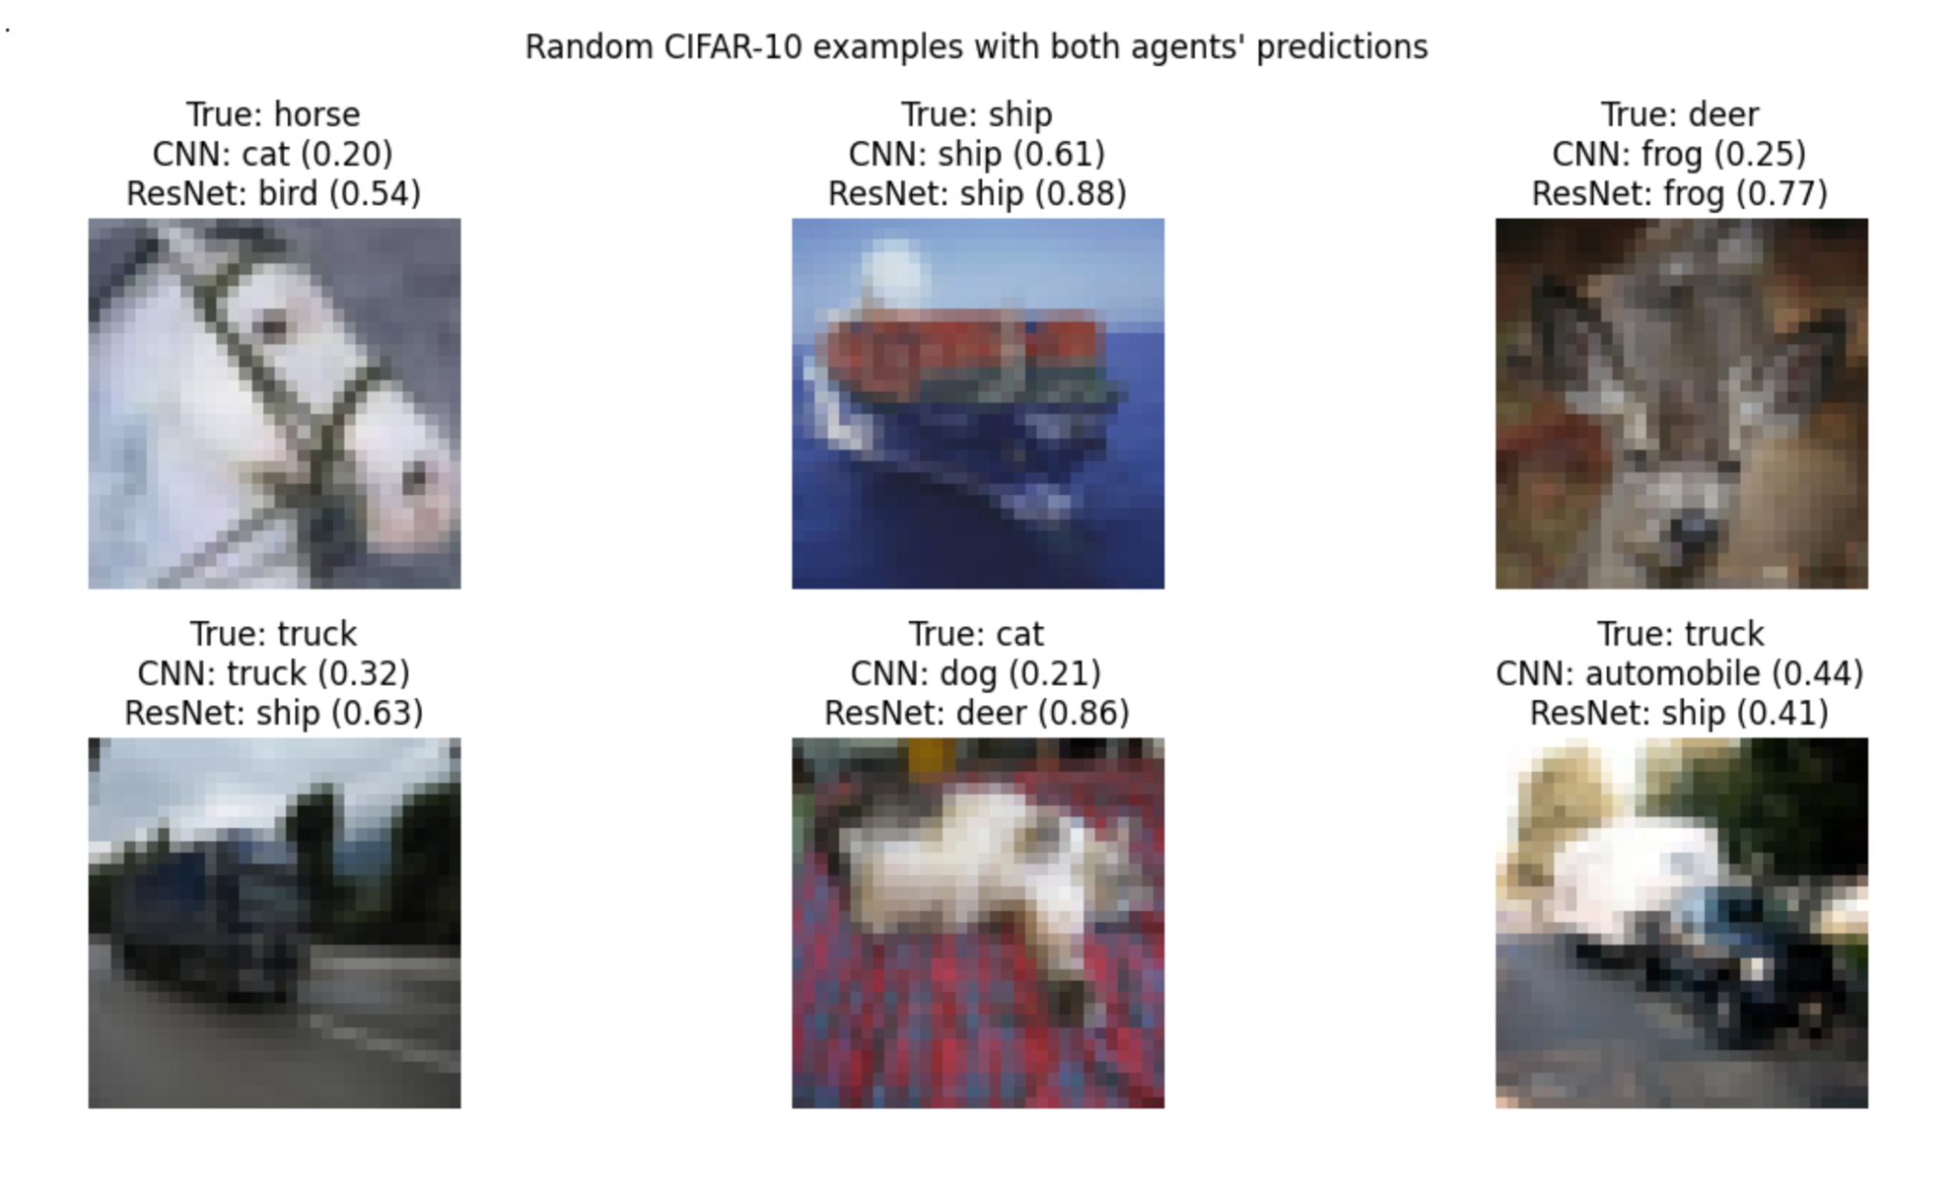
Qualitative Comparison
Visual inspection of predictions shows:
Some images correctly classified by both agents.
Some cases where only one agent was correct.
Confidence scores differ across architectures.
Misclassifications often occur in visually similar classes (e.g., horse vs deer, truck vs automobile).

Slide 7
Role of Judge Agent
The Judge Agent:
Centralizes evaluation logic
Ensures identical inputs for both models
Computes fair comparison metrics
Decouples model implementation from benchmarking
Agentic AI Principle Demonstrated:
Independent agents coordinated by a supervising evaluation agent.

